Slide 1
ESHA European School Heads Association Paul Byrne NAPD Past President & Member of ESHA General Assembly National Association of Principals and Deputy Principals Ireland
The Federation of Secondary Schools and Dormitories of Slovenia
Bled Slovenia
29 - 30 June 2017

Slide 2
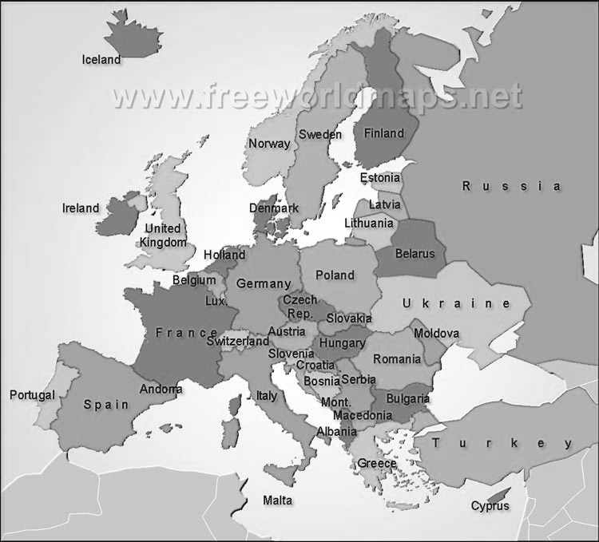
European School Heads Association ESHA
ESHA is an umbrella organisation of national associations for school leaders and leadership teams in (pre)primary, secondary and vocational education
The 43 ESHA member associations represent nearly 70,000 school leaders in 30 European countries.
ESHA acts as a voice for European school leaders with other key education partners and seeks to promote the working conditions of European school leaders.

Slide 3
History & Structure of ESHA
Esha was formed 30 years ago.
It was initially the European Secondary School Association but expanded to include pre-school and primary school.
It has grown to include 43 educational leadership organisations across Europe.
The current ESHA president is Clive Byrne from Ireland .
The ESHA council consists of four members elected from the members of the general assembly .

Slide 4
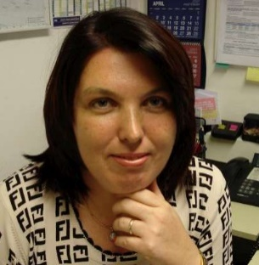
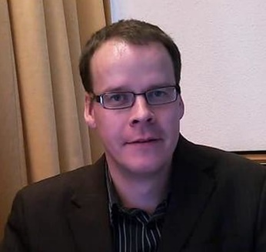
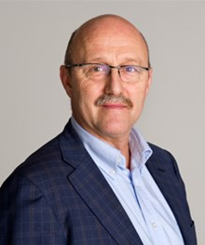
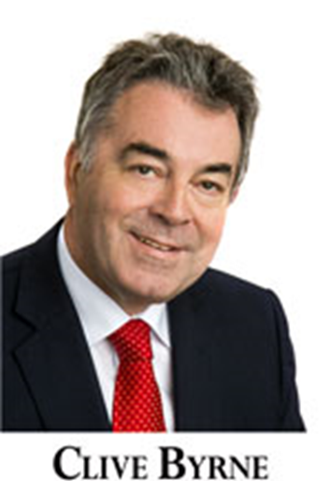
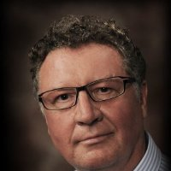
ESHA Board
Ms Barbara Novinec
Slovenia
Greg Dempster
General Secretary
Scotland
Omar Mekki
Norway
Clive Byrne
ESHA President
Ireland
Jens Porsgaard Nielsen
Denmark

Slide 5
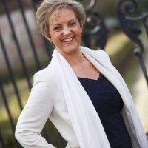
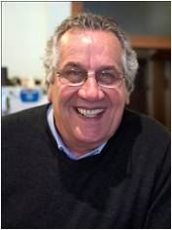
Office Staff
Monique Westland Coordinates all ESHA activities &
acts as the contact person to all member associations.
Fred Verboon
ESHA Director
Fred leads the ESHA offices
Chris Harrison
Chris manages and develops the relationships
with member associations and the
European Commission as Strategic Relations Manager

Slide 6
ESHA Aims
ESHA aims to develop innovative and high quality education and school leadership by;
Acting as an advocate for members.
Researching and reporting on key issues.
Identifying and sharing best practices.
Participating in European projects to create relevant courses and collect examples of best practice on all aspects of school leadership.

Slide 7
ESHA Activity
The ESHA General Assembly meets twice a year.
The Executive Board meets face to face 4 times per year and via Skype when necessary.
ESHA will hold the Biennial Conference next year in Estonia in October 2018.
ESHA has a website rich in content but it has been redesigned and is easier to navigate.
ESHA produces an electronic magazine 6 times a year which has a large readership.

Slide 8
School Leadership and Quality Management
Distributed Leadership
ESHA and ETUCE (European Teachers Association) have published a joint research into distributive leadership. Their publications can be found at the ESHA Community portal.
Managing change
1. Maintaining high quality standards.
2. Resistance to Change.
Reduced Budgets
Administrative Workload

Slide 9
Esha Website

Slide 10
Children
Social Behaviour
Effective strategies to combat bullying in schools
Educate Roma children
LED on values
The David Project
Bullying and Suicide Prevention
Learners with special needs

Slide 11
Learning
Active classroom learning
Flipping classrooms
The Kahn Academy (4 million users)
21st Century Skills
Entrepreneurship, creativity and innovation
Basic Skills
Technology in education
Adult education
ICT in Education
Interesting initiatives

Slide 12
ESHA Magazine
ESHA magazine is the official magazine of the European School Heads Association (ESHA). ESHA magazine will be published ten times a year.

Slide 13
ESHA Projects ; My ESHA

Slide 14
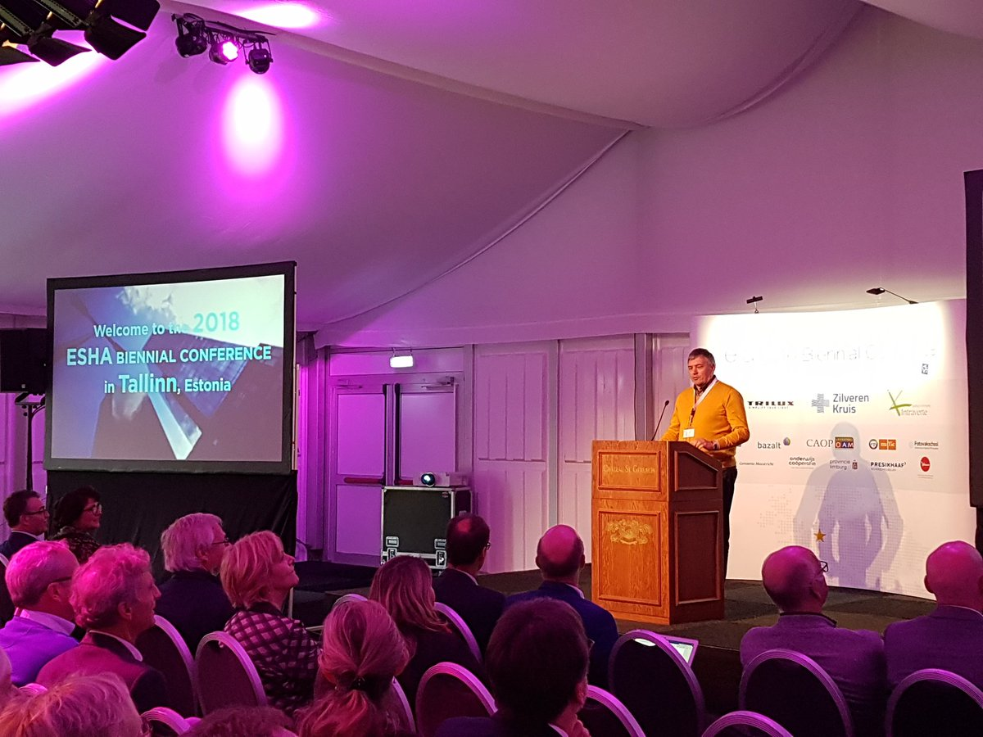
A final word The power of ESHA is in facilitating the sharing best practices between education systems within Europe, in providing a united voice to advocate for the most precious resource we have for the future, the children of our countries. Let us continue to co-operate and share with a view to a better future. Hvala za prijateljstvo in gostoljubje, dokler ne bomo spet srečali.
www.esha.org ESHA website
OECD; Improving School Leadership. Background report; Ireland. Paris (2007)
Slán abhaile – safe home!

