Slide 1
The Irish Education System Irski šolski sistem Paul Byrne NAPD Past President National Association of Principals and Deputy Principals
The Federation of Secondary Schools and Dormitories of Slovenia
Bled, Slovenia.
29 - 30 June 2017

Slide 2
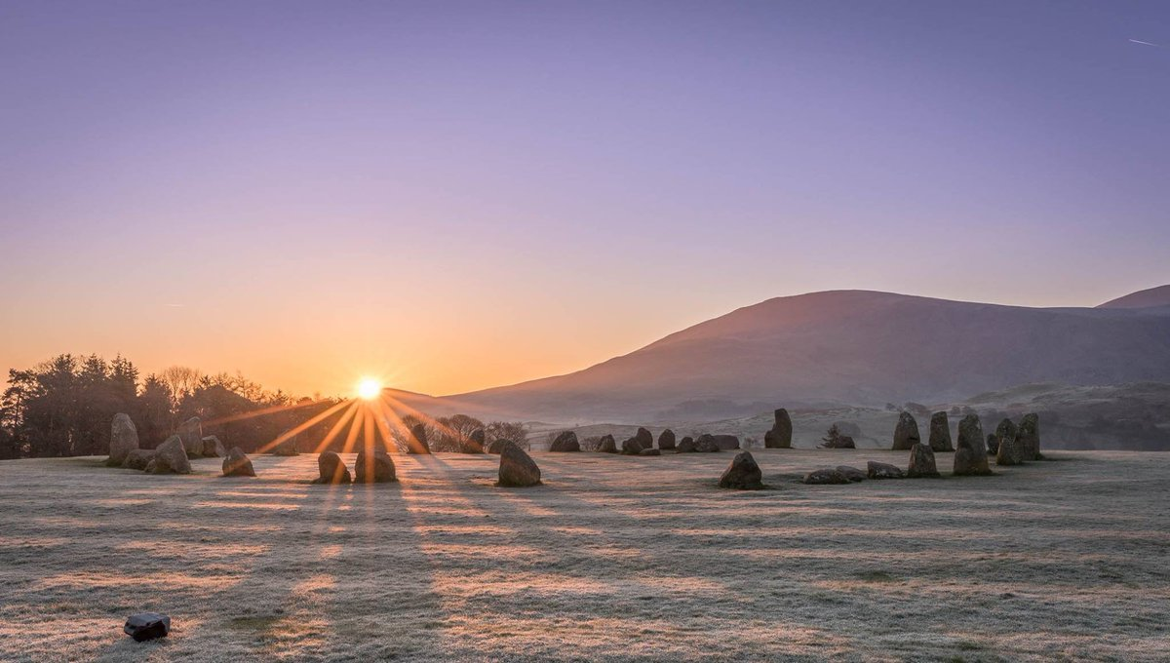
Island of Saints and Scholars otok svetnikov in šolarjev

Slide 3
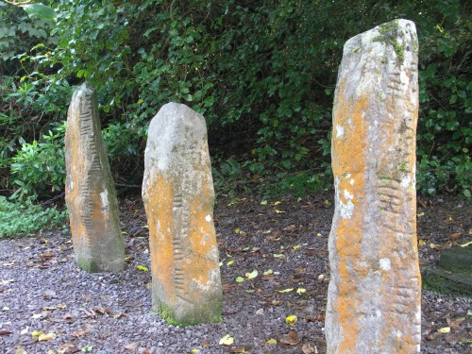
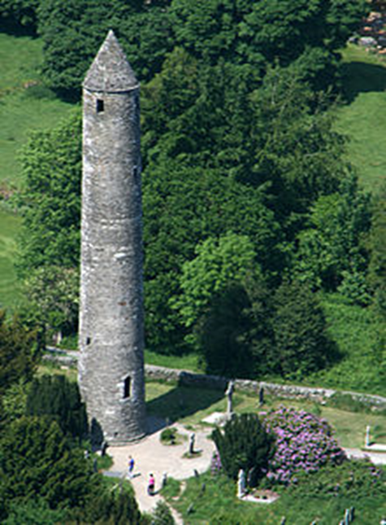
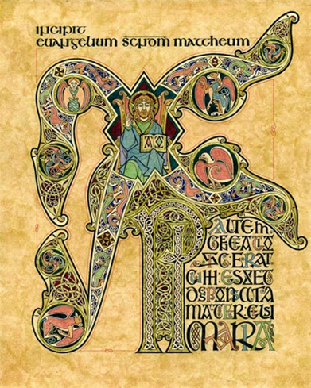
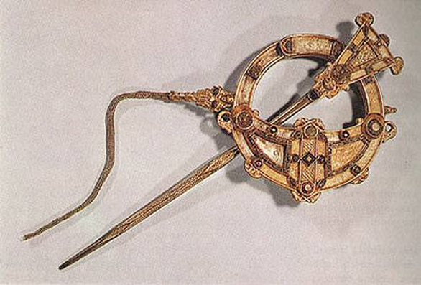
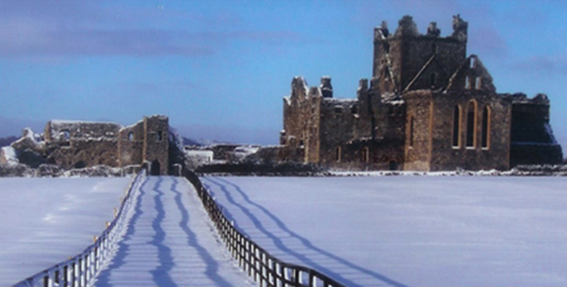
High Points of Irish craft and cultural past
Nekaj poudarkov iz irske obrti in zgodovine
Ogham Stones 5th C

Slide 4
Pre-School and Early Childhood predšolsko obdobje
Pre-schooling is not compulsory.
Mala šola ni obvezna.
Early childhood education is outside the formal education structure but there is a National Quality Framework which regulates it.
To izobraževanje ni vključeno v formalno izobraževanje, je pa regulirano v okviru nacionalnega kakovostnega načrta.
Participation rates in state-funded pre-primary was extremely low. In 2005 only 1.7% participation compared to an EU-14 average of 82.2%
Višina sofinanciranja tega šolanja v državnih ustanovah je zelo nizka. V letu 2005 je znašala le 1.7 % v primerjavi s evropskim povprečjem, ki je 82.2 %.
Pre-primary was predominantly privately funded and very expensive.
Večinoma je bilo to izobraževanje privatno in bilo je zelo drago.

Slide 5
Pre–school and Early Childhood
Limited pilot projects were run in disadvantaged areas and proved very successful.
Nekaj pilotnih projektov je potekalo v neprivilegiranih okoljih in rezultati teh so bili zelo dobri.
Free pre-school year was introduced in 2010 with a 94% take up.
Leta 2010 je država uvedla eno leto brezplačne male šole, ki jo je obiskovalo 94 % otrok.
Age range 3years 2months until 4years 7 months.
Razpon starosti otrok, ki lahko obiskujejo brezplačno leto, sega od 3 let in 2 mesecev do 4 let in 7 mesecev.
Planned expansion of the free pre-school service to 2 years is likely to be very beneficial in future.
Verjamejo, da bosta brezplačni dve leti, ki ju država načrtuje, prinesli dobre rezultate.

Slide 6
Primary Education in Ireland osnovno šolstvo na irskem
Participation in primary education is close to universal.
Vključenost otrok v osnovno šolo se na Irskem bliža stotim odstotkom.
School is compulsory from age 6 but Children can be enrolled in infant class from age 4.
Otoke je treba všolati najkasneje pri starosti 6 let, lahko pa se vključijo v predšolske oddelke pri 4 letih.
About 40% of 4 year olds and all 5 year olds attend school.
Okrog 40 % štiri in petletnikov obiskuje šolo.
The Irish primary school cycle is 8 years. Osnovna šola na Irskem traja 8 let.

Slide 7
Denominational Education is the norm and the influence of the church is enormous.
Versko obarvano izobraževanje je norma in vpliv cerkve je ogromen.
Over 90% of primary schools are run by the Catholic Church through State-aided parish schools.
Več kot 90 % osnovnih šol vodi katoliška cerkev preko župnijskih šol z državno podprto.
However, non-secular primary education is provided by the Educate Together and the Community National School model. This sector is expanding.
Vendar pa za nesekularno osnovnošolsko izobraževanje skrbita organizaciji Izobraževati skupaj in Model skupnosti nacionalne šole. Ta sektor se širi.

Slide 8
With 3,262 there are too many primary schools catering for 553,380 pupils due to the large number of one and two teacher rural primary schools.
Število 3.262 kaže na preveč osnovnih šol za 553,380 učencev, to pa je zaradi velikega števila podeželskih osnovnih šol z enim in dvema učiteljema.
70 % of primary principals are classroom teachers.
70 % ravnateljev je po poklicu učiteljev.
The Irish primary teaching cohort is drawn from the top 14 % of school leavers.
Irska osnovnošolska kohorta pridela14 % osipnikov.
The state pays for but doesn’t control the primary school system; money follows the student by way of capitation.
Država plača, vendar ne nadzoruje osnovnošolskega sistema; plačani so po vsakem učencu.

Slide 9
Primary Education in Ireland
Between the years 1997 and 2013 spending on primary education doubled from €2,950 to €6,274 per child but financial pressure in recent years has reduced this slightly.
Med leti 1997 in 2013 so se izdatki za osnovnošolsko izobraževanje podvojili od € 2.950 do 6.274 € na otroka, a finančna stiska je to povečevanje v zadnjih letih nekoliko zmanjšala.
Irish primary teachers work 941 hours/year which exceeds the OECD average 810 hours/year however the Irish school year is shorter than the OECD average.
Irski osnovnošolski učitelji delajo 941 ur / leto, kar presega OECD-jevo povprečno 810 ur / leto, je pa irsko šolsko leto krajše od povprečja v OECD.

Slide 10
Primary Education in Ireland
Time spent on key skills in Maths, Science and Technology was among the lowest in the OECD but is improving.
Čas, porabljen za ključne spretnosti pri matematiki, znanosti in tehnologiji je med najnižjimi v OECD, vendar se izboljšuje.
Key policy agendas are:- social inclusion, special needs, increasing school places and revising curriculum to improve literacy & numeracy.
Ključna področja so: - socialna vključenost, posebne potrebe, povečanje šolskih površin in revizija učnih načrtov za izboljšanje jezikovne in matematične pismenosti.
The increase in population in recent years has put serious stress on the primary school system.
Povečanje števila prebivalstva v zadnjih letih pomeni resen pritisk na osnovnošolski sistem

Slide 11
Post Primary System
The Irish secondary system is a 5 or 6 year cycle catering for 345,550 pupils.
Irske srednje šole tajajo pet ali šest let ali ciklov, vanje je vključenih 345.550 dijakov.
There are 735 schools divided in 3 different sectors.
V 3 različnih sektorjih je 735 šol.
There are 26,800 teachers in the secondary system.

Slide 12
V srednješolskem sistemu je zaposlenih 26.800 učiteljev.
Each school has its own Board of Management.
Vsaka šola ima svoj upravni odbor.
Significant industrial unrest in the sector as a result of pay cuts and moves to curricular reform.
Pojavljajo se precejšnji industrijski nemiri v sektorju zaradi zmanjšanja plač in prehoda k kurikularni reformi.

Slide 13
The Post Primary System
3 Types of Second level schools
Imajo tri vrste srednjih šol, v katere se vpišejo po osnovni šoli.
Voluntary Secondary – just under 400 schools mostly managed by religious. Nekaj manj kot 400 versko obarvanih šol
Vocational Schools and Colleges – about 220 schools run by Education and Training Boards. Poklicne in srednje strokovne šole, teh je okrog 220, vodijo jih odbori za izobraževanje in prakso.
Community and Comprehensive Schools – about 100 schools organised through Deeds of Trust between the state and religious congregations. Teh šol je 100 in zanje je značilno, da se pri njihovem vodenju povezujeta država in verske skupnosti.

Slide 14
Post Primary System continued
Transfer from primary at age 12 - 13 from primary system.
Otroci preidejo iz osnovne šole pri starosti 12 – 13 let.
Very broad curriculum in first year but a new curriculum is being implemented. ( Industrial Unrest)
Kurikul je zelo obsežen v prvem letu, zato načrtujejo implementacijo novega kurikula na pobudo gospodarstva.
Slightly fewer subjects in second year.
Malo manj je predmetov v drugem letu.

Slide 15
First state exam (Junior Certificate -JCSA) in Third Year (aged 15-16)
Prvo državno zunanje preverjanje znanja poteka v tretjem letu izobraževanja ( starost 15-16)
Majority of Students do Transition Year.
Večina dijakov opravlja eno leto, ki ga poimenujejo prehodno leto.
The Leaving Certificate begins in Fifth Year – students take 7 or 8 subjects for their final exams.
Zaključni certifikat opravljajo v petem letu, dijaki si izberejo 7 ali 8 premetov za zaključne izpite.

Slide 16
Transfer from Second level to Third Level
The best six scores in the Leaving Cert are taken into account for entry into Third level – a system described as brutal but fair!
Pri vpisu in prehodu na Tretjo raven se upošteva šest najboljših rezultatov pridobljenih v Zaključnem certifikatu. To je kruto, a pošteno.
92 % of the cohort who begin school at 4 are still in the system aged 18.
92 % množice, ki začne svojo izobraževalno pot pri 4 letih je pri letih 18
še vedno v šoli.
43 % of the 24-35 age group has a Third level qualification (OECD average of 35 %)
43 % oseb v starostni skupini od 24-35 let ima tako imenovani Third level qualification (povprečje v OECD je 35 %)
52 % oseb v starostni skupini od 30-35 let (EU povprečje je 38%)
Številke pri tej stopnji izobrazbe rastejo iz 44 % v letu 1998, 55 % v letu 2004 in danes na 70 %

Slide 17
Second level continued
Major investment in second level in the last decade from €4,557 in 1997 to €8,864 per pupil in 2007 but down to €8,252 in 2013 largely down to an increase in pupil numbers.
V zadnjem desetletju so se povečala sredstva za financiranje v srednjih šolah, in sicer od €4,557 na dijaka v letu 1997 na €8,864 v letu 2007, toda leta 2013 se je ta znesek zaradi povečanega števila dijakov precej znižal.
Pupils receive 802 hours instruction for Irish 15 year olds compared to 910 in the OECD.
Irski 15- letni dijaki imajo v izobraževanju 802 ur pomoči, ostali v OECD pa 910 ur.

Slide 18
Target of 90 % completion rate by 2020 has already been reached.
Cilj, da 90 % dijakov do 2020 zaključi izobraževanje, so že dosegli.
Loud cry from industry for more honours maths and science graduates to drive the smart or knowledge economy.
Industrija glasno zahteva več diplomantov matematike in tehničnih smeri, ki bodo sposobni voditi pametno ekonomijo/družbo znanja.

Slide 19
Relevant statistics statistika
Primary pupil teacher ratio – 16:1
Razmerje učitelj učenec v OŠ je 16:1
Post –primary pupil teacher ratio – 19:1
Razmerje dijak učitelj je 19:1
Ed Expenditure as % of GDP – 4.1% - EU 5%
Povečanje sredstev za izobraževanje v BDP znaša 4,1 %, v EU je 5 %

Slide 20
Education as % of total public expenditure – 10.1%
Izobraževanje predstavlja 10,1 % javne porabe
34,576 teachers at primary level
34,576 učiteljev v OŠ
26,804 teachers at second level
26,804 učiteljev v SŠ

Slide 21
Teachers’ Pay učiteljeva plača
Common basic 25 point scale for primary and post primary – a major source of disharmony since the recession.
Skupna osnovna lestvica, ki od recesije obsega 25 točk tako za učitelje OŠ kot SŠ je glavni vzrok neskladja
Start at €30,702 – recent improvements for certain teachers.
Začetnik začne pri 30.702 € - zgodile so se nedavne izboljšave za nekatere učitelje.

Slide 22
Principals and Deputy Principals allowances and initiatives
Common basic scale still applies
P/DP allowance depends on the size of the school, no. of teachers and students
8 teacher principal €14,360
8 teacher deputy €8,173
61+ teachers principal €42,490
61+ teachers deputy €27,217
Insufficient difference in salary between principal and deputy.
Recent initiatives of the Centre for School Leadership and additional deputy positions

Slide 23
After 25 years €53,423.
Po 25 letih je plača 53.423 €.
Another incresment after 10 years at the top of the scale.
Še eno napredovanje po 10 letih na vrh lestvice.
Professional Diploma allowance €1,112
dodatek za stokovno diplomo1.112 €
Honours Degree allowance €4,426
Dodatek za splošno diplomo 4.426 evrov

Slide 24
Promotional Posts napredovanje
Was dependent on seniority – different now.
Je bilo odvisno od starosti - zdaj je to drugače urejeno.
It is common for teachers in Ireland to be appointed and to retire from the same school.
Za učitelje na Irskem je običajno, da delajo na isti šoli vse do upokojitve.
Assistant Principal €8520.
Pomočnik ravnatelja zasluži 8520 EUR.

Slide 25
Special Duties Teacher €3769.
Učitelj za posebne naloge zasluži 3769 €.
Although these were middle-leadership posts there was little responsibility attached.
Čeprav so to delovna mesta v srednjih vodstvenih položajih, je njihova odgovornost majhna.
Sometimes there is a reduction in class contact hours from 22 hours to 20 or 18.
Včasih se število ur učiteljem v razredu zmanjša od 22 ur na 20 ali na 18.

Slide 26
NAPD
Established in 1998 as a result of the amalgamation of 6 disparate representative bodies.
Ustanovljen je bil leta 1998 kot rezultat združitve 6 različnih predstavniških teles.
NAPD is a professional association. It doesn’t deal with salary or conditions of employment. It is not a union.
NAPD je profesionalno združenje. Ne ukvarja se s plačami ali pogoji zaposlitve. To ni sindikat.

Slide 27
To show leadership in the formulation of educational policy.
Sodelovati pri oblikovanju izobraževalne politike.
To promote professional and personal development.
Spodbujati poklicni in osebni razvoj.
To be proactive in developing an international and European dimension – NAPD is a member of ICP and of ESHA.
Želi delovati proaktivno pri razvoju mednarodne in evropske razsežnosti - NAPD je član ICP in ESHA.
To promote international reasearces.
Spodbujati strategije za razvoj raziskav.
.

Slide 28
The Irish Principal has responsibility in 6 main areas irski ravnatelji so odgovorni za 6 temeljnih področij
Managing the curriculum by leading learning.
Upravljanje kurikuluma z vodenjem za učenje.
Human resource management
Upravljanje s človeškimi viri
Financial Management but little discretion
Finančno upravljanje, vendar ne popolnoma samostojno

Slide 29
Administration and paper work
Upravno in papirno delo
Plant management – is the building safe?
Upravljanje nepremičnin - ali je stavba varna?
Secretary (but not a full member of) to the Board of Management of the school
Je sekretar (vendar ne polnopravni član) v upravi šole

Slide 30
Who will replace the Existing Cohort of Irish School Leaders? Kdo bo zamenjal sedanjo množico ravnateljev na irskem?
Negatives Negativno
Lack of contractual definition of the job.
Pomanjkanje pogodbene opredelitve delovnega mesta.
Increasing legislative requirements.
Povečanje zakonodajnih zahtev
Poor support infrastructure at school level.
Slaba podporna infrastruktura na šoli.
Increasing demands on personal time.
Vse večje zahteve po osebnem času.

Slide 31
Events and meetings after school.
Dogodki in sestanki po šoli.
Perception of inadequate remuneration.
Plačilo je neustrezno.
Lack of opportunity for sabbatical leave.
Pomanjkanje priložnosti za oddih.
Labour, Equality & Health & Safety legislation makes HR management very complex – professional conversation equals bullying.
Zakonodaja o delu, enakosti, zdravju in varnosti pri delu otežuje vodenje zaposlenih - strokovni pogovor se enači z ustrahovanjem.
Positive Pozitivno
Centre for School Leadership supporting school leaders through mentoring and coaching & training aspiring leaders,.
Center za vodenje, ki podpira ravnatelje z mentorstvom, treningom ter usposabljanjem vodij,…

Slide 32
National Action Plan for Education nacionalni akcijski načrt za izobraževanje
To become the best Education System in Europe by 2026.
Vzpostaviti najboljši šolski sistem v Evropi do 2016.
To introduce coding to primary and secondary education.
Uvesti kodiranje v osnovno in srednjo šolo.
A 10 year plan which exceeds the life span of the government.
Narediti 10-letni načrt, ki presega življenjsko dobo vlade.

Slide 33
To increase the numbers of recognised apprenticeships.
Povečati število priznanih in uveljavljenih vajeništev.
To increase the numbers taking apprenticeships.
Povečanje števila v vajeništvu.
To improve participation in higher level maths.
Izboljšati dosežke v matematiki na višji stopnji.
All of the above are achievable but are dependent on government resources. We look forward to future of education in Ireland
Vse navedeno je mogoče doseči, vendar je odvisno od državnega vlaganja. Veselimo se prihodnosti izobraževanja na Irskem.

